Slide 1
Guide to Computer Forensics and Investigations
Third Edition
Chapter 8
Macintosh and Linux Boot Processes and File Systems

Slide 2
Objectives
Explain Macintosh file structures and the boot process
Explain UNIX and Linux disk structures and boot processes
Describe other disk structures
Guide to Computer Forensics and Investigations

Slide 3
Understanding the Macintosh File Structure and Boot Process
Mac OS X version 10.4
  Darwin core
  BSD UNIX application layer
Hierarchical File System (HFS)
  Files stored in nested directories (folders)
Extended Format File System (HFS+)
  Introduced with Mac OS 8.1
  Supports smaller file sizes on larger volumes, resulting in more efficient disk use
Guide to Computer Forensics and Investigations

Slide 4
Understanding the Macintosh File Structure and Boot Process (continued)
File Manager utility
  Reading, writing, and storing data to physical media
Finder
  Keeps track of files and maintain users’ desktops
In older Mac OSs, a file consists of two parts:
  Data fork and resource fork
  Stores file metadata and application information
Guide to Computer Forensics and Investigations

Slide 5
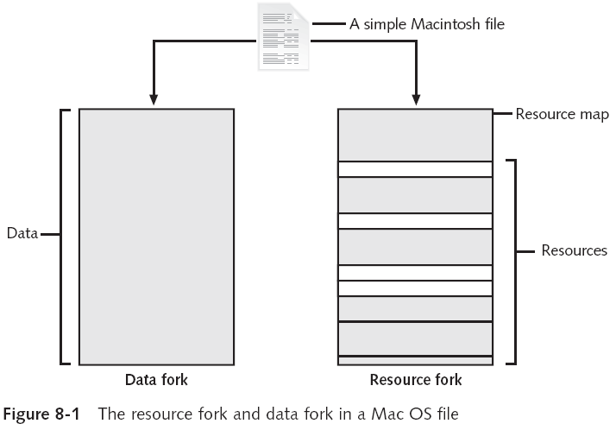
Guide to Computer Forensics and Investigations

Slide 6
Understanding Macintosh OS 9 Volumes
A volume is any storage medium used to store files
  Can be all or part of a hard disk
  On a floppy disk is always the entire disk
Allocation and logical blocks
  Logical blocks cannot exceed 512 bytes
  Allocation blocks are a set of consecutive logical blocks
Guide to Computer Forensics and Investigations

Slide 7
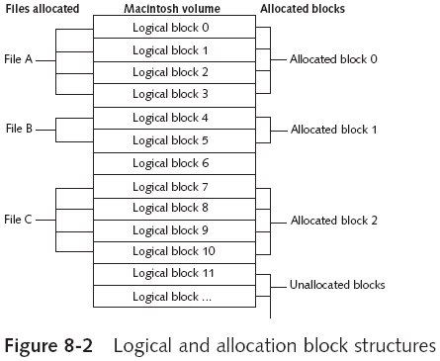
Understanding Macintosh OS 9 Volumes (continued)
Guide to Computer Forensics and Investigations

Slide 8
Understanding Macintosh OS 9 Volumes (continued)
Two EOF descriptors
  Logical EOF
    Actual size of the file
  Physical EOF
    The number of allocation blocks for that file
Clumps
  Groups of contiguous allocation blocks
  Reduce fragmentation
Guide to Computer Forensics and Investigations

Slide 9
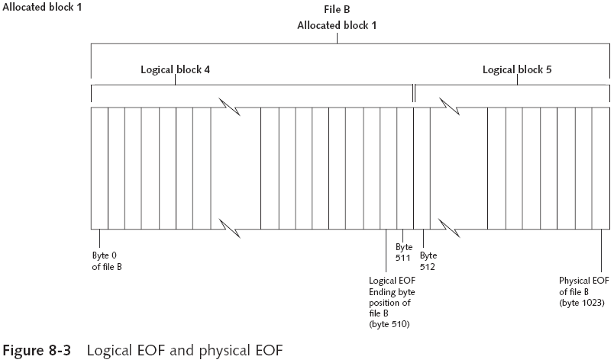
Understanding Macintosh OS 9 Volumes (continued)
Guide to Computer Forensics and Investigations

Slide 10
Exploring Macintosh Boot Tasks
Use Open Firmware
  Processor- and system-independent firmware
  Controls microprocessor after hardware initialization
The boot process for OS 9 is as follows:
  1. Power on the computer
  2. Hardware self-test and Open Firmware run
  3. Macintosh OS starts
  4. The startup disk is located
  5. System files are opened
Guide to Computer Forensics and Investigations

Slide 11
Exploring Macintosh Boot Tasks (continued)
The boot process for OS 9 (continued):
  6. System extensions are loaded
  7. OS 9 Finder starts
Tables 8-1 and 8-2 are an overview of how HFS and HFS+ system files handle data
Guide to Computer Forensics and Investigations

Slide 12
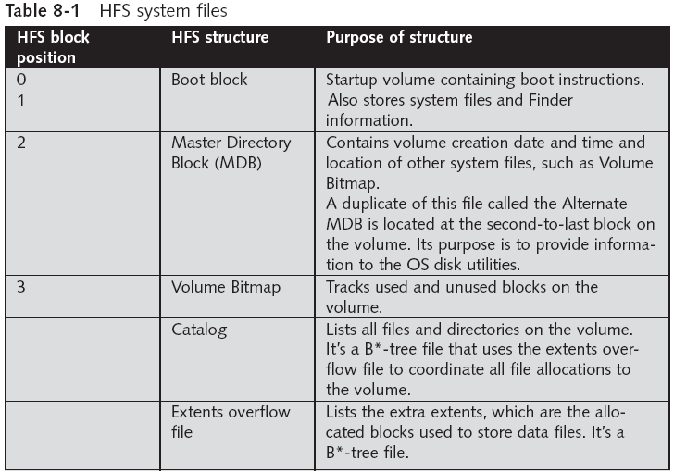
Guide to Computer Forensics and Investigations

Slide 13
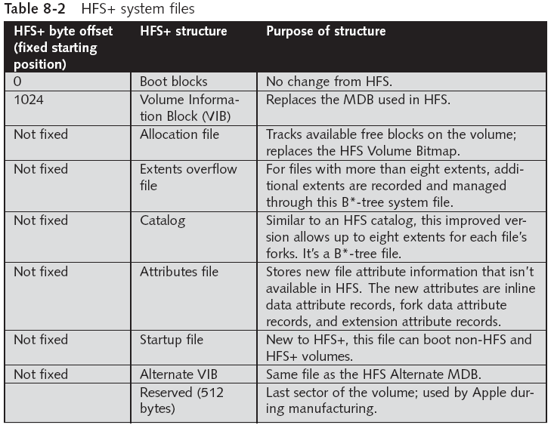
Guide to Computer Forensics and Investigations

Slide 14
Exploring Macintosh Boot Tasks (continued)
Older Macintosh OSs use
  First two logical blocks as boot blocks
  Master Directory Block (MDB) or Volume Information Block (VIB)
    Stores all information about a volume
  Volume Control Block (VCB)
    Stores information from the MDB when OS mounts
Extents overflow file
  Stores any file information not in the MDB or a VCB
Guide to Computer Forensics and Investigations

Slide 15
Exploring Macintosh Boot Tasks (continued)
Catalog
  Listing of all files and directories on the volume
  Maintains relationships between files and directories
Volume Bitmap
  Tracks used and unused blocks on a volume
Mac OS 9 uses the B*-tree file system for File Manager
  Actual file data is stored on the leaf nodes
  B*-tree also uses header, index, and map nodes
Guide to Computer Forensics and Investigations

Slide 16
Using Macintosh Forensic Software
Tools and vendors
  BlackBag Technologies
  SubRosaSoft MacForensicsLab
  Guidance EnCase
  X-Ways Forensics
  ProDiscover Forensic Edition
  Sleuth Kit and Autopsy
Guide to Computer Forensics and Investigations

Slide 17
Using Macintosh Forensic Software (continued)
Macintosh Acquisition Methods
  Make an image of the drive
  Static acquisition of the suspect drive is preferable to a live acquisition
  Removing the drive from a Macintosh Mini’s CPU case is difficult
    Attempting to do so without Apple factory training could damage the computer
  Use a Macintosh-compatible forensic boot CD to make an image
Guide to Computer Forensics and Investigations

Slide 18
Using Macintosh Forensic Software (continued)
Macintosh Acquisition Methods (continued)
  BlackBag Technologies sells acquisition products specifically designed for OS 9 and earlier
    As well as OS X
  MacQuisition is a forensic boot CD that makes an image of a Macintosh drive
  After making an acquisition, examine the image of the file system
    The tool you use depends on the image file format
Guide to Computer Forensics and Investigations

Slide 19
Using Macintosh Forensic Software (continued)
Macintosh Acquisition Methods (continued)
  BlackBag Technologies Macintosh Forensic Software and SubRosaSoft MacForensicsLab
    Can disable/enable Disk Arbitration
  Being able to turn off the mount function in OS X
    Allows you to connect a suspect drive to a Macintosh without a write-blocking device
Guide to Computer Forensics and Investigations

Slide 20
Using Macintosh Forensic Software (continued)
Examining OS 9 Data Structures with BlackBag
  Activities in this section assume you have a Macintosh running OS X
  All data acquisitions (image files) must be configured as Disk Images
    With the correct filename and extensions
  To keep the correct order of each segment
    Numbers need to be inserted between the filename and the extension
      See Table 8-3
Guide to Computer Forensics and Investigations

Slide 21
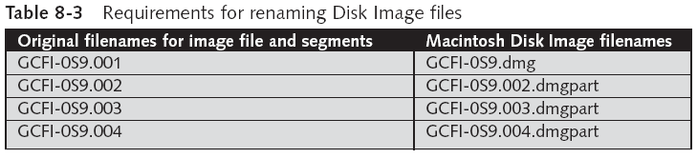
Using Macintosh Forensic Software (continued)
Guide to Computer Forensics and Investigations

Slide 22
Using Macintosh Forensic Software (continued)
Examining OS 9 Data Structures with BlackBag (continued)
  Load images as a virtual disk image double-clicking the files in Finder
    See Figure 8-4
  OS X loads and displays an icon of the virtual mounted disk with the name “untitled” on the desktop
    You can rename it with your case name
    See Figure 8-5
Guide to Computer Forensics and Investigations

Slide 23
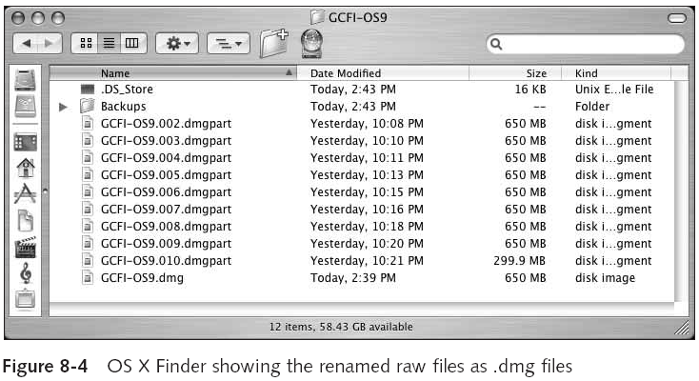
Using Macintosh Forensic Software (continued)
Guide to Computer Forensics and Investigations

Slide 24
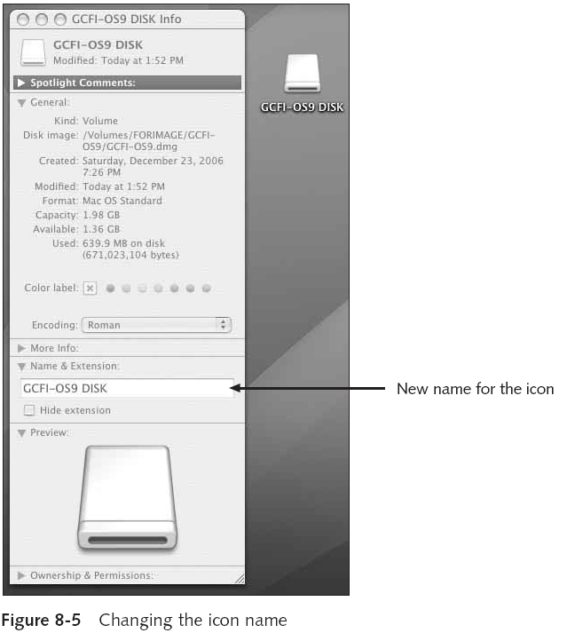
Guide to Computer Forensics and Investigations

Slide 25
Using Macintosh Forensic Software (continued)
Examining OS 9 Data Structures with BlackBag (continued)
  Start BlackBag from Finder
    See Figure 8-6
  BlackBag includes several utilities for conducting a full analysis of evidence, including
    PDISKInfo, PMAPInfo, DirectoryScan, FileSearch, MacCarver, and FileSpy
Guide to Computer Forensics and Investigations

Slide 26
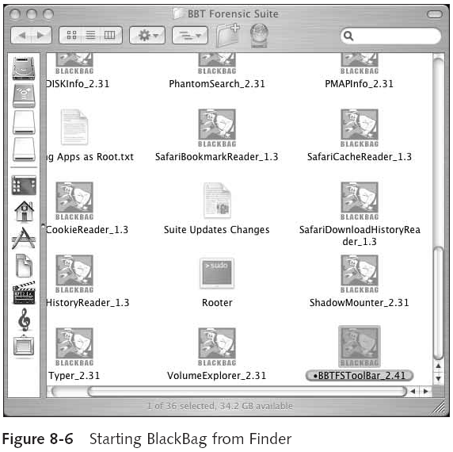
Guide to Computer Forensics and Investigations

Slide 27
Using Macintosh Forensic Software (continued)
Examining OS 9 Data Structures with BlackBag (continued)
  Activity 1:
    Use the BlackBag DirectoryScan utility, which lists all folders and files, visible and hidden, in the image loaded as a .dmg file
    See Figure 8-8
  Activity 2:
    Use the FileSearcher utility to locate files by a specific extension
    See Figure 8-9
Guide to Computer Forensics and Investigations

Slide 28
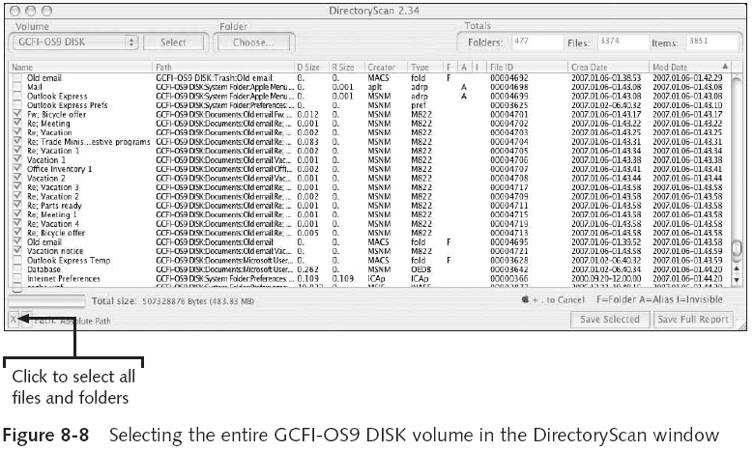
Using Macintosh Forensic Software (continued)
Guide to Computer Forensics and Investigations

Slide 29
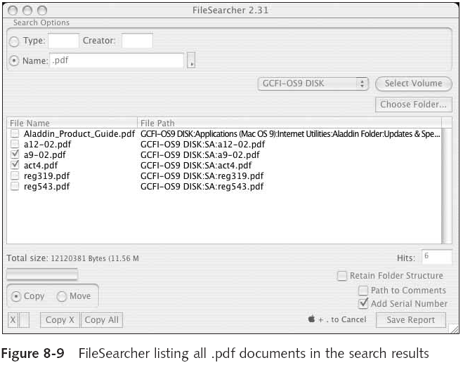
Guide to Computer Forensics and Investigations

Slide 30
Examining UNIX and Linux Disk Structures and Boot Processes
UNIX flavors
  System V variants, Sun Solaris, IBM AIX, and HP-UX
  BSD, FreeBSD, OpenBSD, and NetBSD
Linux distributions
  Red Hat, Fedora, Ubuntu, and Debian
  Most consistent UNIX-like OSs
Linux kernel is regulated under the GNU General Public License (GPL) agreement
Guide to Computer Forensics and Investigations

Slide 31
Examining UNIX and Linux Disk Structures and Boot Processes (continued)
BSD license is similar to the GPL
  But makes no requirements for derivative works
Some useful Linux commands to find information about your Linux system
  uname –a
  ls –l
  ls –ul filename
  netstat -s
Guide to Computer Forensics and Investigations

Slide 32
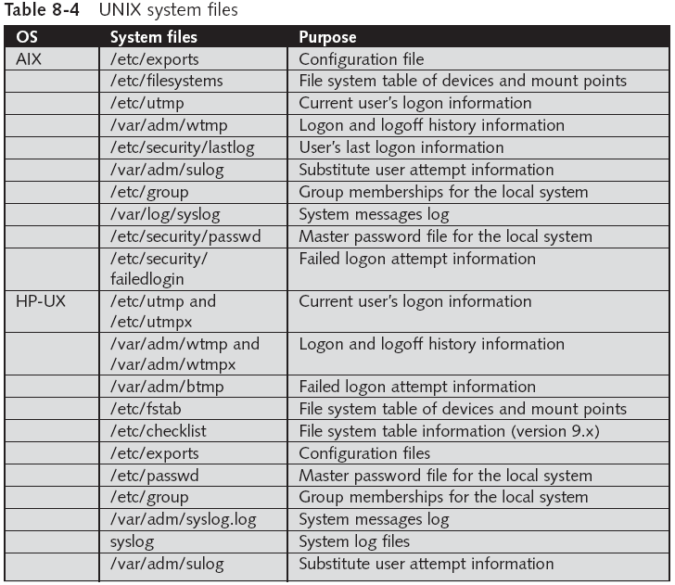
Guide to Computer Forensics and Investigations

Slide 33
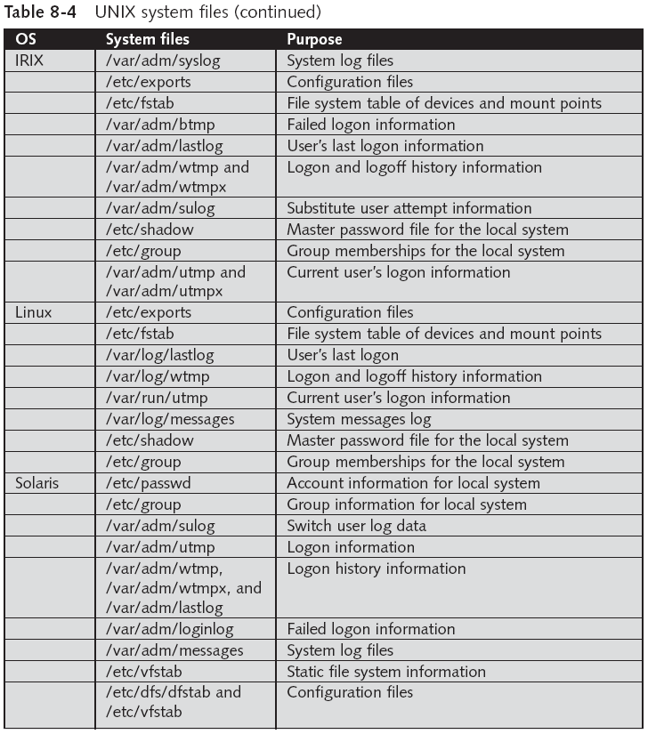
Guide to Computer Forensics and Investigations

Slide 34
Examining UNIX and Linux Disk Structures and Boot Processes (continued)
Linux file systems
  Second Extended File System (Ext2fs)
  Ext3fs, journaling version of Ext2fs
Employs inodes
  Contain information about each file or directory
  Pointer to other inodes or blocks
  Keep internal link count
    Deleted inodes have count value 0
Guide to Computer Forensics and Investigations

Slide 35
UNIX and Linux Overview
Everything is a file
  Files are objects with properties and methods
UNIX consists of four components
Boot block
  Block is a disk allocation unit of at least 512 bytes
  Contains the bootstrap code
  UNIX/Linux computer has only one boot block, located on the main hard disk
Guide to Computer Forensics and Investigations

Slide 36
UNIX and Linux Overview (continued)
Superblock
  Indicates disk geometry, available space, and location of the first inode
  Manages the file system
Inode blocks
  First data after the superblock
  Assigned to every file allocation unit
Data blocks
  Where directories and files are stored
  This location is linked directly to inodes
Guide to Computer Forensics and Investigations

Slide 37
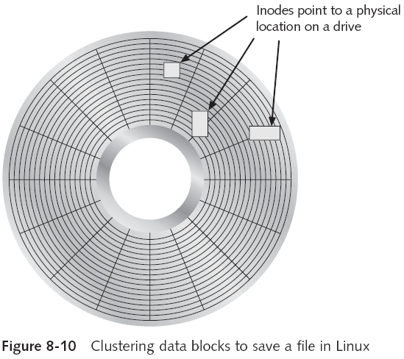
UNIX and Linux Overview (continued)
Guide to Computer Forensics and Investigations

Slide 38
UNIX and Linux Overview (continued)
Bad block inode
  Keeps track of disk’s bad sectors
  Commands: badblocks, mke2fs, and e2fsck/
Linux ls command displays information about files and directories
Continuation inode
  Provides information about a file or directory
    Mode and file type, the quantity of links in the file or directory, the file or directory status flag
Guide to Computer Forensics and Investigations

Slide 39
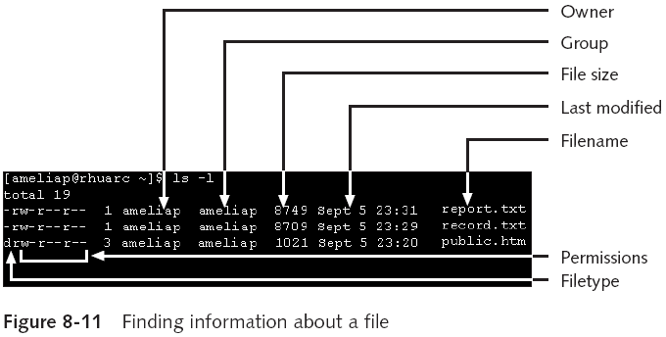
UNIX and Linux Overview (continued)
Guide to Computer Forensics and Investigations

Slide 40
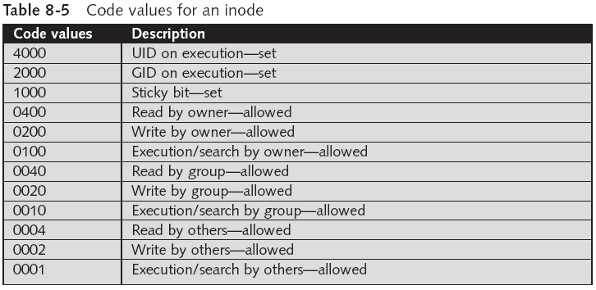
UNIX and Linux Overview (continued)
Guide to Computer Forensics and Investigations

Slide 41
Understanding Inodes
Link data stored in data blocks
Ext2fs and Ext3fs are improvements over Ext
  Data recovery easier on Ext3fs than on Ext2fs
First inode has 13 pointers
  Pointers 1 to 10 are direct pointers to data storage blocks
  Pointer 11 is an indirect pointer
  Pointer 12 is a double-indirect pointer
  Pointer 13 is a triple-indirect pointer
Guide to Computer Forensics and Investigations

Slide 42
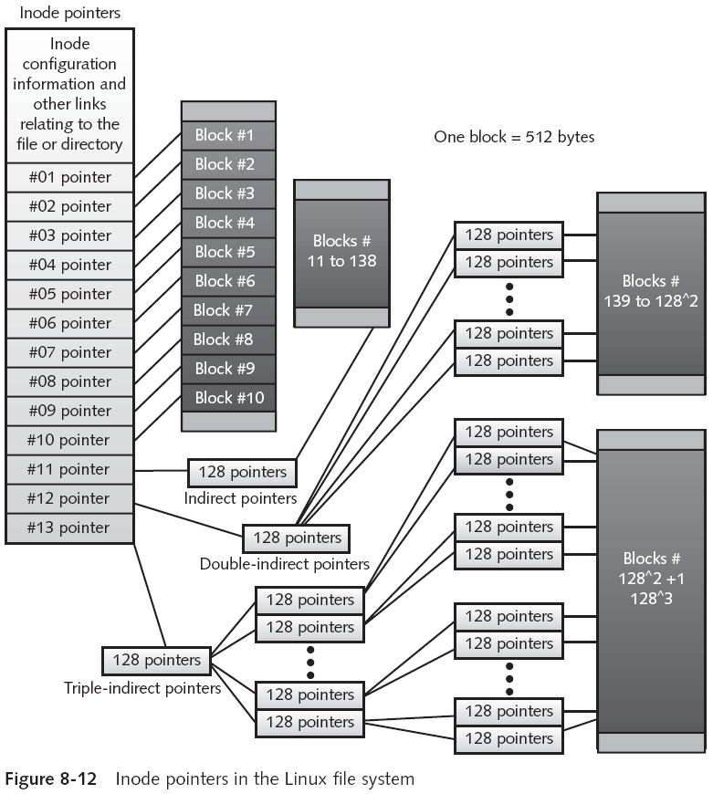
Guide to Computer Forensics and Investigations

Slide 43
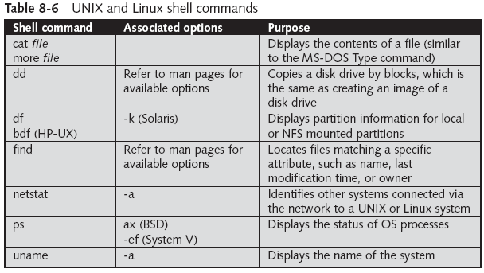
Understanding Inodes (continued)
Guide to Computer Forensics and Investigations

Slide 44
Understanding UNIX and Linux Boot Processes
Instruction code in firmware is loaded into RAM
Instruction code then:
  Checks the hardware
  Load the boot program
Boot program
  Loads kernel
  Transfers control to kernel
Kernel’s first task is to identify all devices
Guide to Computer Forensics and Investigations

Slide 45
Understanding UNIX and Linux Boot Processes (continued)
Kernel
  Boots system on single-user mode
  Runs startup scripts
  Changes to multiuser mode
  Identifies root directory, swap, and dump files
  Sets hostname and time zone
  Runs consistency checks on the file system and mounts partitions
  Starts services and sets up the NIC
  Establishes user and system accounting and quotas
Guide to Computer Forensics and Investigations

Slide 46
Understanding Linux Loader and GRUB
Linux Loader (LILO)
  Old boot manager
  Can start two or more OSs
  Uses configuration file Lilo.conf
Grand Unified Boot Loader (GRUB)
  More powerful than LILO
  As LILO, it resides on MBR
  Command line or menu driven
Guide to Computer Forensics and Investigations

Slide 47
Understanding UNIX and Linux Drives and Partition Schemes
Labeled as path starting at root (/) directory
  Primary master disk (/dev/had)
    First partition is /dev/hda1
    Second partition is /dev/hda2
  Primary slave or secondary master or slave (/dev/hdb)
    First partition is /dev/hdb2
  SCSI controllers
    /dev/sda with first partition /dev/sda1
    Linux treats SATA, USB, and FireWire devices the same way as SCSI devices
Guide to Computer Forensics and Investigations

Slide 48
Examining UNIX and Linux Disk Structures
Most commercial computer forensics tools can analyze UNIX UFS and UFS2
  And Linux Ext2, Ext3, ReiserFS, and Reiser4 file systems
Freeware tools include Sleuth Kit and its Web browser interface, Autopsy Browser
Foremost
  A freeware carving tool that can read many image file formats
  Configuration file: foremost.conf
Guide to Computer Forensics and Investigations

Slide 49
Examining UNIX and Linux Disk Structures (continued)
Tarball
  A data file containing one or more files or whole directories and their contents
Installing Sleuth Kit and Autopsy
  Requires downloading and installing the most recent updates of these tools
  Download the most current source code from www.sleuthkit.org
  To run Sleuth Kit and Autopsy Browser, you need to have root privileges
Guide to Computer Forensics and Investigations

Slide 50
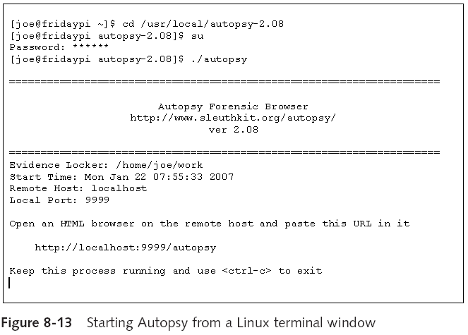
Examining UNIX and Linux Disk Structures (continued)
Guide to Computer Forensics and Investigations

Slide 51
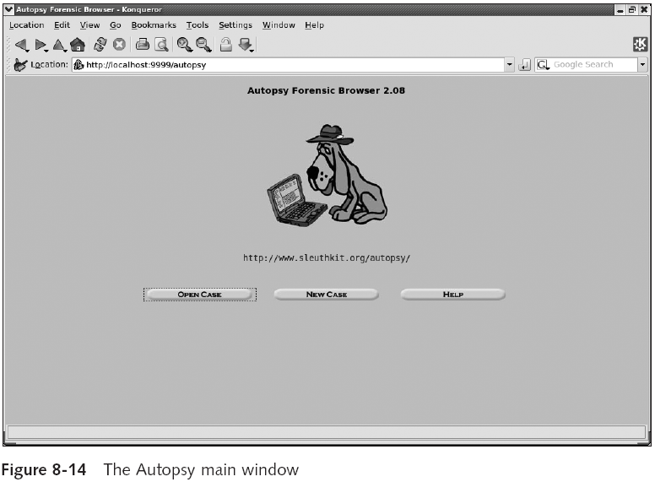
Guide to Computer Forensics and Investigations

Slide 52
Examining UNIX and Linux Disk Structures (continued)
Examining a case with Sleuth Kit and Autopsy
  Use Sleuth Kit and Autopsy Browser to analyze a Linux Ext2 and Ext3 file system
    See Figures 8-15 through 8-18
Guide to Computer Forensics and Investigations

Slide 53
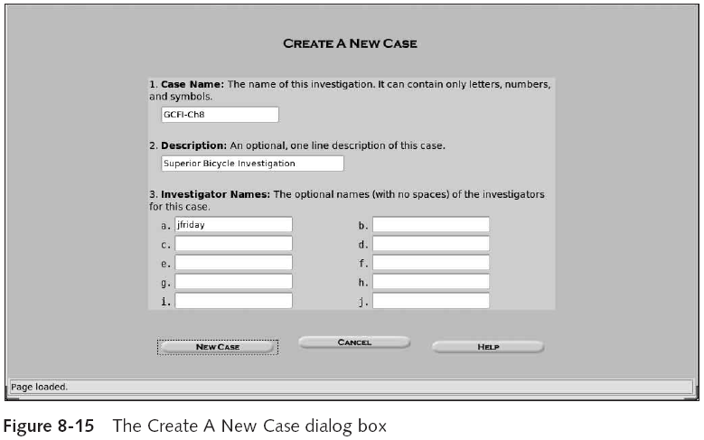
Examining UNIX and Linux Disk Structures (continued)
Guide to Computer Forensics and Investigations

Slide 54
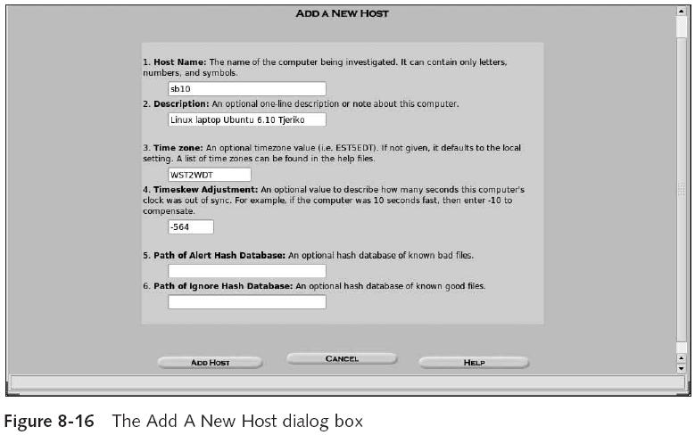
Examining UNIX and Linux Disk Structures (continued)
Guide to Computer Forensics and Investigations

Slide 55
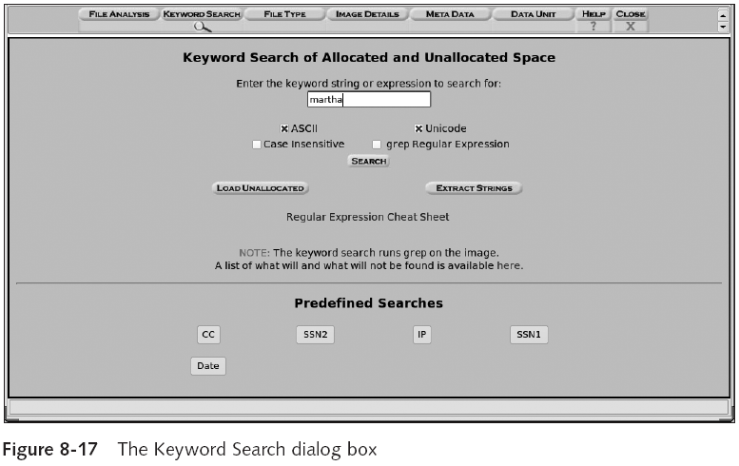
Examining UNIX and Linux Disk Structures (continued)
Guide to Computer Forensics and Investigations

Slide 56
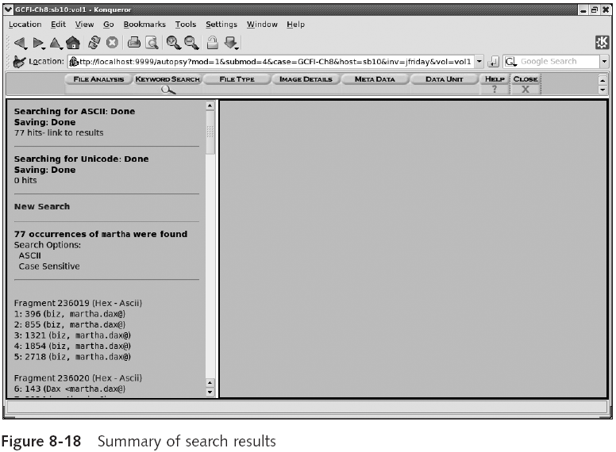
Guide to Computer Forensics and Investigations

Slide 57
Examining UNIX and Linux Disk Structures (continued)
Examining a case with Sleuth Kit and Autopsy (continued)
  Use the File Activity Time Lines function
    Identifies what files were active at a specific time
    See Figures 8-19 and 8-20
Guide to Computer Forensics and Investigations

Slide 58
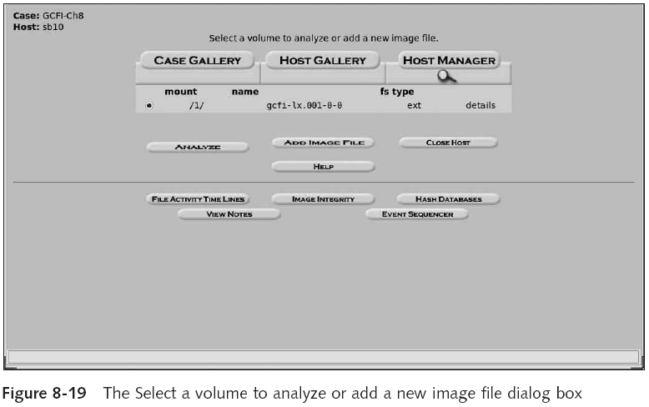
Examining UNIX and Linux Disk Structures (continued)
Guide to Computer Forensics and Investigations

Slide 59
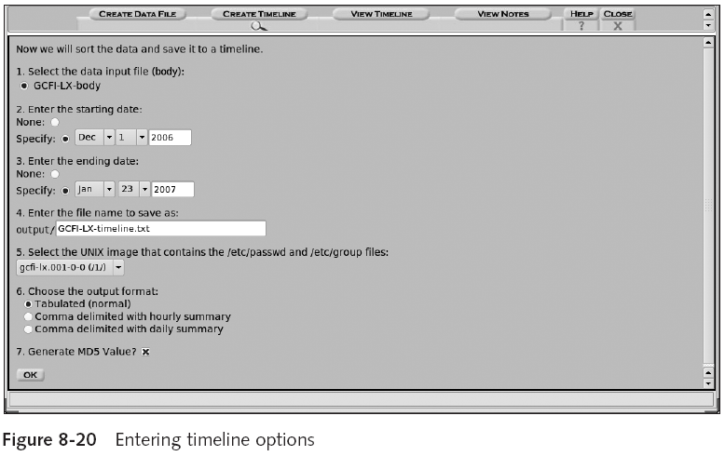
Examining UNIX and Linux Disk Structures (continued)
Guide to Computer Forensics and Investigations

Slide 60
Understanding Other Disk Structures
SCSI disks
IDE/EIDE disks
SATA drives
Guide to Computer Forensics and Investigations

Slide 61
Examining CD Data Structures
Laser burns flat areas (lands)
Lower areas are called pits
Transitions
  From lands to pits have binary value 1 (on)
  No transition has binary value 0 (off)
International Organization of Standards (ISO)
  ISO 9660 for CD, CD-R and CD-RW
  ISO 13346 for DVDs
Guide to Computer Forensics and Investigations

Slide 62
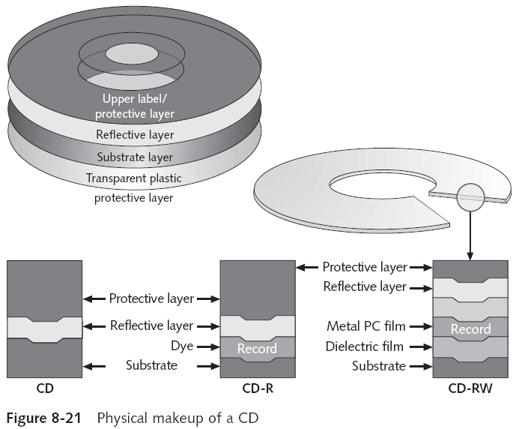
Guide to Computer Forensics and Investigations

Slide 63
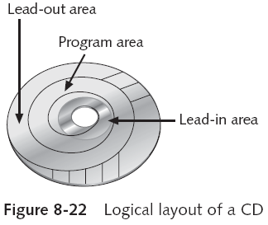
Examining CD Data Structures (continued)
Guide to Computer Forensics and Investigations

Slide 64
Examining CD Data Structures (continued)
Frame is the unit storage
  Contains 24 17-bits symbols
Frames are combined into blocks
Blocks are combined into sectors
  2352 bytes for CD-DA
  2048 bytes for CD
Constant Linear Velocity (< 12X)
Constant Angular Velocity (>= 12X)
Guide to Computer Forensics and Investigations

Slide 65
Examining CD Data Structures (continued)
DVD disk file structures use a Universal Disk Format (UDF)
  Called Micro-UDF (M-UDF)
For backward compatibility, some DVDs have integrated ISO 9660
  To allow compatibility with current OSs
Guide to Computer Forensics and Investigations

Slide 66
Examining SCSI Disks
Small Computer System Interface (SCSI)
  Provides a common bus communication device
During investigation
  Check if the device is internal or external
  Check if card, cables, adapters, terminators, and drivers are available
Advance SCSI Programming Interface (ASPI)
  Provides several software drivers for communication between the OS and SCSI component
Guide to Computer Forensics and Investigations

Slide 67
Examining SCSI Disks (continued)
Might need to adjust settings
  Port numbers and terminators
Newer SCSI devices typically use an integrated self-terminator
One problem with older SCSI drives is identifying which jumper group terminates and assigns a port number
Guide to Computer Forensics and Investigations

Slide 68
Examining IDE/EIDE and SATA Devices
Most forensic disk examinations involve EIDE and SATA drives
ATA drives from ATA-33 to ATA-133
  Standard 40-pin ribbon or shielded cable
  40-pin/80-wire cable for ATA-66, 100, and 133
CMOS identifies proper disk settings using:
  Logical block addressing (LBA)
  Enhanced CHS configurations
Can be a problem during an investigation
Guide to Computer Forensics and Investigations

Slide 69
Examining IDE/EIDE and SATA Devices (continued)
Solutions
  Use disk imaging tools
  Use an old PC
  Cards and adapters
    ISA SCSI card
    A-Card IDE adapter
    SCSI-to-IDE adapter
    EISA FireWire card
    FireWire-to-EIDE adapter
Guide to Computer Forensics and Investigations

Slide 70
Examining IDE/EIDE and SATA Devices (continued)
Examining the IDE host protected area
  ATAPI-5 AT introduced in 1998 reserved and protected areas on IDE devices
    Protected Area Run Time Interface Extension Service (PARTIES)
  Data stored by diagnostic and restore programs
  Tools
    X-Ways Replica
  HPA is also referred to as a BIOS Engineering Extension Record (BEER) data structure
Guide to Computer Forensics and Investigations

Slide 71
Examining IDE/EIDE and SATA Devices (continued)
Exploring hidden partitions
  Suspects try to conceal evidence by hiding disk partitions
  Norton Disk Edit can change the disk partition table
    Leaving no indication that the deactivated partition exists
  Use imaging tools that can access unpartitioned areas of a drive
Guide to Computer Forensics and Investigations

Slide 72
Summary
Macintosh uses HFS
  Hierarchical structure
Mac OS file structure
  Data fork and resource fork
Volume refers to any storage media
  Allocation and logical blocks
Ext2fs uses inodes
  Ext3fs: journaling version of Ext2fs
Guide to Computer Forensics and Investigations

Slide 73
Summary (continued)
Linux file structure
  Metadata and data
CD and DVDs are optical media
  ISO 9660 and 13346
Other device technologies
  SCSI
  IDE/EIDE
  SATA
Guide to Computer Forensics and Investigations

